Slide 1
Zowe Conformance Review and Roadmap

Slide 2
Agenda
Conformance “Must Knows”
Operations
Key points
Versioning
Conformance Next Steps
App Directory
vNext Testing and Timing
NPM Tagging
Questions

Slide 3
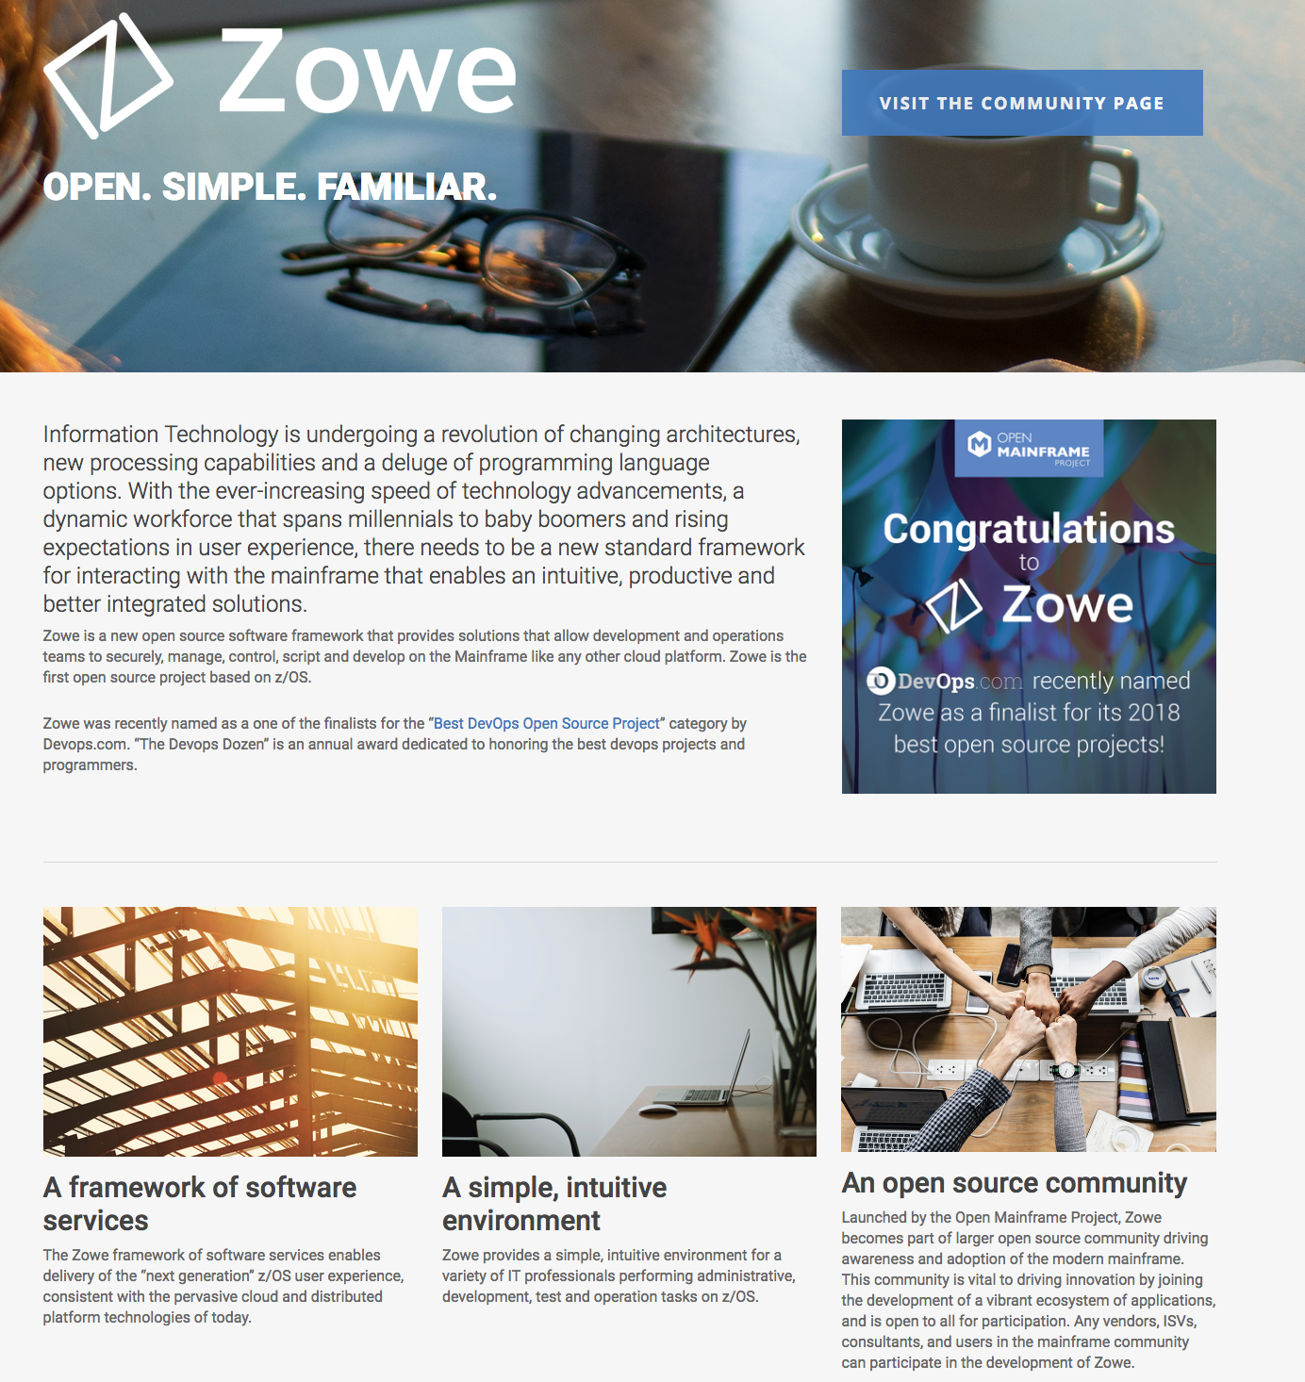
Conformance Program Official Links
Terms and Conditions:
https://www.openmainframeproject.org/projects/zowe/conformance/terms-and-conditions
Test Evaluation Guide:
https://www.openmainframeproject.org/projects/zowe/conformance/test-evaluation-guide
Participation Form:
https://www.openmainframeproject.org/projects/zowe/conformance/participation-form
Branding Guide:
https://www.openmainframeproject.org/projects/zowe/conformance/branding-guide
OMP is developing a Conformance Landing Page to be part of the OMP Zowe Project Page to house these links.
Targeting the official launch of the program to align with OSS NA, August 20th
https://www.openmainframeproject.org/projects/zowe

Slide 4
“Must Knows”
Program Ts&Cs (as currently written) and Operations
Process
1) Identifying Offerings: “Qualifying Offering must be tested against the most recent version…”
2) Apply: Submission via DocuSign
3) Test: “self-testing”
4) Submit Test Results: OMP/LF receives all submissions and “results may be made available to the public”
5) Successful Review: “The LF may share test results with members of the Zowe project community if the LF deems it necessary and appropriate… with confirming that tests have been passed or failed…”
6) Ongoing Conformance:
Conformance Test Versions: “Qualifying offering is tied to a specific version of Conformance” and must “meet the updated evaluation criteria within 60 days” following a new version.
Reported Non-Conformance: Qualifying Offering will have 30 days following a written notice from the LF to confirm it meets conformance.
Removal of the Conformance Marks at the End of Conformance or Participation: Participants will have 30 days to remove Marks from existing marketing material or websites.

Slide 5
“Must Knows”
Zowe Conformance Test Evaluation Guide
Self-Service Tests
Items marked (required) are required for achieving conformance in a given program aka “component”
Formatting differs from the confluence site

Slide 6
“Must Knows”
Participation Form
Only Open Mainframe Project member organizations can submit for conformance, unlimited time, for free
Fee for non-member orgs seeking conformance will be the same as their membership fees (based on size of organization)
A participating offering may submit for one or more of the Zowe Conformance types (API Mediation Layer, CLI and/or App Framework) in a single application.

Slide 7

“Must Knows”
Branding Guidelines

Slide 8
“Must Knows”
Versioning is based on the year the conformance criteria was published and enforced
It is not currently tied to a version of the code released
How does this relate to LTSR?
Need to keep all conformant participants informed of program developments

Slide 9
Next Steps
App Directory
OMP to manage and update the App Directory - as it is tied to the conformance approval process
Need to confirm what information will be collected and shared in the App Directory:
Name, Conformance “Level”, Link to approved participation form?, link to participant managed offering website to learn more?
Looking to use similar format to K8s

Slide 10
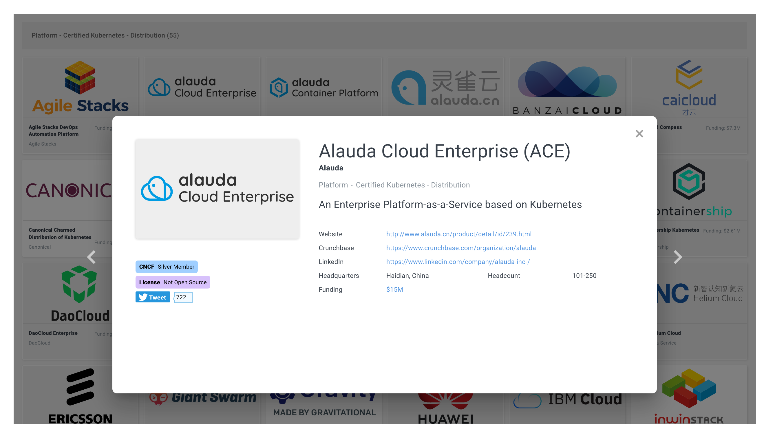
https://www.cncf.io/certification/software-conformance/

Slide 11
vNext Testing and Timing
Need to work across squads to investigate how we can make conformance criteria more “objective”
Actual tests (code) that can validate and generate a report
Report could then be submitted via the participant form
Review program Ts&Cs for reproducibility clause
Need to understand how Zowe and the Conformance Program versioning and release cadence coincide
Update all stakeholders 1-month prior to “launching” an updated conformance program/criteria

Slide 12
vNext
NPM Tagging
https://www.npmjs.com/search?q=%40zowe
Discussions being had on the confluence site (led by Mark A)
https://wiki.zowe.org/display/ZCP/Zowe+Conformant+Branding+Guidelines

Slide 13
Questions?
For more in-depth review SHARE session:
Session 25116 - Tuesday 10:00 AM - 11:00 AM

Slide 14

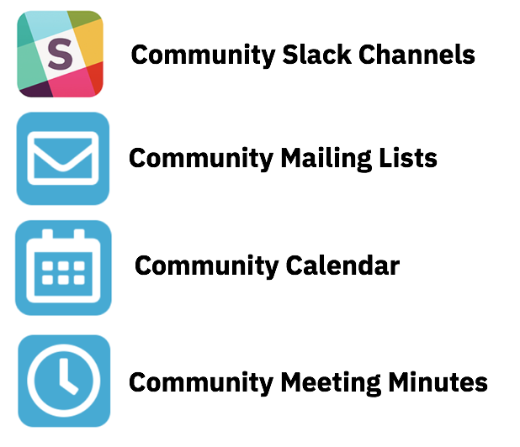
Getting Involved with Zowe!
Project Community site
https://zowe. org
Zowe “vNext” Roadmap
https://github.com/zowe/zlc/blob/master/tracking/Roadmap.md
Access to Zowe Convenience Deliverables
https://zowe.org/download
Review Zowe squads, missions and activities
https://zowe.org/contribute/
Project Governance
https://zowe.org/about-us/
GitHub
https://github.com/zowe
Project Documentation (includes user and install guides)
https://zowe.github.io/docs-site/
Developer Tutorials
https://zowe.github.io/docs-site/guides/intro.html
https://developer.ibm.com/tutorials/zowe-step-by-step-tutorial/

Slide 15



Get involved in the Zowe community
Join Open Source Community @ https://www.openmainframeproject.org/projects/zowe
PROJECTS
Participate in and contribute to the Zowe developer community at zowe.org
Learn how your organization can become a steward and supporter of this project with Open Mainframe Project membership at openmainframeproject.org/about/join
DEVELOPER
COMMUNITY
PLATFORM
PARTICIPATION
Ecosystem
PROFITS
PRODUCTS
PROMOTION
SOFTWARE

